Slide 1

Stay-N-Sleep Loyalty Program
Final Presentation
by: Motolani Alimi

Slide 2

Final Presentation:
Stay- N-Sleep
Final Presentation
Executive Summary:
Current Problem:
Stay-N-Sleep is facing challenges in customer retention and maximizing customer lifetime value.
Existing loyalty programs lack engagement and fail to reward frequent users effectively.
Recommendations
Introduce a tiered loyalty program with personalized rewards.
Leverage technology to enhance the customer experience and encourage program participation.
Create a roadmap for the loyalty program's successful implementation.

Slide 3
Final Presentation:
Stay- N-Sleep
Final Presentation
User Personas:
Business Traveler Thomas
Family Vacationer Ruby
Frequent Explorer Harold
Hypothesis:
"We believe by introducing a tiered loyalty program tailored to individual guest preferences, Stay-N-Sleep can increase customer retention by 20% within the first year and enhance customer lifetime value by providing relevant, personalized rewards."

Slide 4
Final Presentation
Validation Process
User Persona Validation: Experiment: Create surveys and conduct interviews with your existing customers to validate the user personas (Business Traveler Thomas, Family Vacationer Ruby, Frequent Explorer Harold) Validation Criteria: Look for patterns and commonalities in responses. Ensure that personas accurately represent your customer base. | Tiered Loyalty Benefits: Experiment: Roll out a limited version of the tiered loyalty program with a small group of users. Offer them the benefits of the Silver, Gold, and Platinum tiers. Validation Criteria: Monitor the behavior of users in different tiers. Assess whether they show increased loyalty, such as more frequent bookings or higher spending.
How would you prioritize these features (Feedback Plan)? Experiment: Implement a feedback Plan within the loyalty program where users can provide input and suggestions. Validation Criteria: Collect and analyze user feedback to identify pain points, areas for improvement, and new feature requests. | MVP LAUNCH Experiment: Launch the Minimum Viable Product of the loyalty program to a broader audience, targeting a segment of your existing customer base. Validation Criteria: Track key performance metrics, such as customer retention, increased bookings, and customer lifetime value, for this segment compared to those not enrolled in the program.

Slide 5
Final Presentation:
Stay- N-Sleep
Final Presentation
PRD & MVP Features: Write a comprehensive Product Requirements Document (PRD) detailing the feature set, user needs, and technical specifications. Define the Minimum Viable Product (MVP) features for your loyalty program.
Link to SNS PRD here

Slide 6
Final Presentation:
MVP Features
Stay- N-Sleep
Final Presentation
Feature/Functionality | In MVP? | Why?
User Enrollment & Profile (Month 7) | Yes | User registration and profile creation Initial Loyalty tier assignment based on past stays
Tiered Rewards (Month 8) | Yes | Three-tier loyalty system: Silver, Gold, Platinum Tier-specific discounts and benefits
Personalized Offers (Month 9) | Yes | AI-driven recommendation engine Personalized booking suggestions and discounts
Mobile App (Month 9) | Yes | Loyalty program dashboard Booking and redemption through the app.

Slide 7
Outcome-based Product Roadmap
Final Presentation
Research & Planning (Month 1-2)
Define User Personas
Validate Opportunity Hypotheses
Research Industry best practices
Design & Development (Month 3 - 6)
Create wireframes and Prototypes
Develop the Loyalty Program Infrastructure
Design User interfaces
Testing & MVP Launch (Month 7-9)
Conduct usability testing
Launch the Minimum Viable Product (MVP)
Collect user feedback
Iterate & Refine (Month 10-12)
Analyze MVP Performance
Implement user feedback
Plan for feature enhancements
Scale & Marketing (Ongoing)
Expand the loyalty Program to a wider audience
Implement marketing campaigns
Monitor Program growth

Slide 8
Final Presentation
Proof of Concept: SNS user flow
Frequent Explorer Harold
Business Traveler Thomas
User Registration
Initial Tier Assignment
Home Screen
Exploring Tiers
Personalized Offers
Booking a Stay
Redeeming Rewards
Earning Points
Tracking Progress
Silver
Gold
Platinum
Family Vacationer Ruby
Notes:
User Registration
The user starts by registering for the loyalty program.
They provide basic information and preferences.
Initial Tier Assignment
The system assigns the user to an initial loyalty tier based on their past stays or preferences.
Home Screen
After logging in, the user sees the loyalty program's home screen.
It provides an overview of their current tier, points, and available rewards.
Exploring Tiers
Users can explore different loyalty tiers (Silver, Gold, Platinum) to see their benefits.
Personalized Offers
The system uses AI-driven recommendations to display personalized offers to the user.
Offers are tailored based on their preferences and past stays.
Booking a Stay
Users can book a stay directly through the loyalty program, with discounts and benefits applied based on their tier.
Redeeming Rewards
Users can redeem rewards, such as room upgrades or discounts, during the booking process.
Earning Points
Users earn points for each stay, which contribute to their tier status and unlock additional benefits.
Tracking Progress
The loyalty program provides a way for users to track their progress toward the next tier

Slide 9
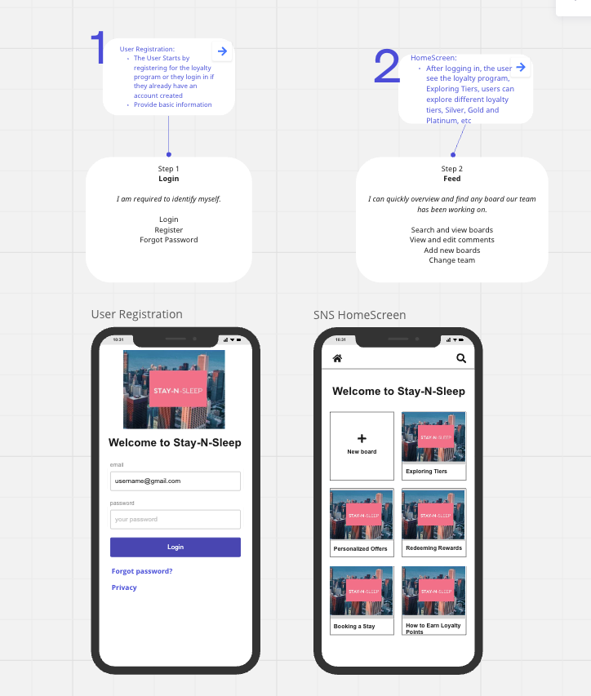
Final Presentation
Proof of Concept: SNS Wireframe
Notes:
User Registration
The user starts by registering for the loyalty program.
They provide basic information and preferences.
Initial Tier Assignment
The system assigns the user to an initial loyalty tier based on their past stays or preferences.
Home Screen
After logging in, the user sees the loyalty program's home screen.
It provides an overview of their current tier, points, and available rewards.
Exploring Tiers
Users can explore different loyalty tiers (Silver, Gold, Platinum) to see their benefits.
Personalized Offers
The system uses AI-driven recommendations to display personalized offers to the user.
Offers are tailored based on their preferences and past stays.
Booking a Stay
Users can book a stay directly through the loyalty program, with discounts and benefits applied based on their tier.
Redeeming Rewards
Users can redeem rewards, such as room upgrades or discounts, during the booking process.
Earning Points
Users earn points for each stay, which contribute to their tier status and unlock additional benefits.
Tracking Progress
The loyalty program provides a way for users to track their progress toward the next tier

Slide 10
Final Presentation:
Stay- N-Sleep
Final Presentation
Engineering Sprints: Break down user stories into sprints, providing a detailed overview of the product development process from an engineering perspective.
Link: Sprint
Notes:
Engineering Sprints
Sprint 1: Research & Planning (Month 1-2)
User Stories:
As a product manager, I want to define user personas for the loyalty program.
As a product manager, I want to create an opportunity hypothesis statement for the new program.
Tasks:
Conduct user research to identify personas.
Analyze data to validate the opportunity hypothesis.
Sprint 2: Design & Prototyping (Month 3-4)
User Stories:
As a user, I want to see wireframes of the loyalty program's key screens.
As a user, I want a visual representation of the user flow.
Tasks:
Create wireframes for key screens.
Develop a visual user flow diagram.
Sprint 3: MVP Development (Month 5-8)
User Stories:
As a user, I want to be able to register for the loyalty program.
As a user, I want to see my initial loyalty tier upon registration.
As a user, I want to view personalized offers.
As a user, I want to book a stay through the loyalty program.
As a user, I want to track my progress towards the next tier.
Tasks:
Develop user registration functionality.
Implement initial tier assignment logic.
Create the personalized offers section.
Build the booking feature.
Develop the progress tracking mechanism.
Sprint 4: Usability Testing & Refinement (Month 9-10)
User Stories:
As a product manager, I want to conduct usability testing.
As a product manager, I want to collect user feedback for improvements.
Tasks:
Plan and execute usability testing sessions.
Collect and analyze user feedback.
Make necessary refinements to the loyalty program.
Sprint 5: Launch & Scale (Month 11-12)
User Stories:
As a product manager, I want to launch the Minimum Viable Product (MVP).
As a product manager, I want to monitor program growth and engagement.
Tasks:
Launch the MVP to a broader audience.
Implement tracking mechanisms for user engagement and growth.
Monitor KPIs to assess the program's success.

Slide 11
Final Presentation:
Stay- N-Sleep
Final Presentation
Metrics & KPIs: Identify and explain the metrics you would use to measure the progress towards your goal.
Link: Metrics & KPIs

Slide 12
Final Presentation:
Stay- N-Sleep
Final Presentation
Go to Market Strategy:
Customer Message: "Unlock a World of Rewards with Stay-N-Sleep Loyalty Program! Enjoy personalized offers, exclusive discounts, and an unforgettable guest experience. Join now to elevate your stays with us."
Propose a customer message, identify potential customer acquisition channels, and outline your go-to-market strategy.
Link: Go to Market Strategy

Slide 13

Final Presentation:
Stay- N-Sleep
Final Presentation

